Slide 1
Building a “Magic Mirror”
Experiences Shared

Slide 2
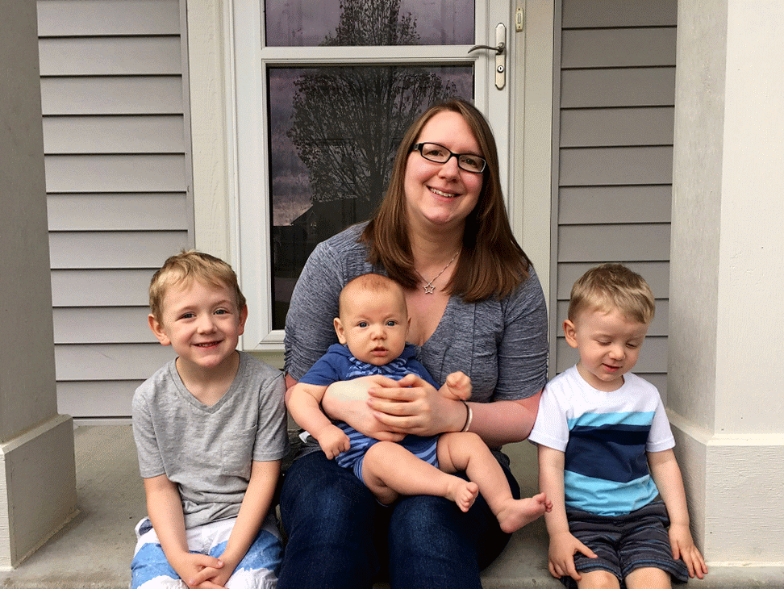
My Family

Slide 3





Hi, I’m David Pine { Microsoft Evangelist @ Centare }
https://www.linkedin.com/in/dpine
David Pine
@davidpine7
IEvangelist
https://ievangelist.github.io

Slide 4











Community Soapbox

Slide 5
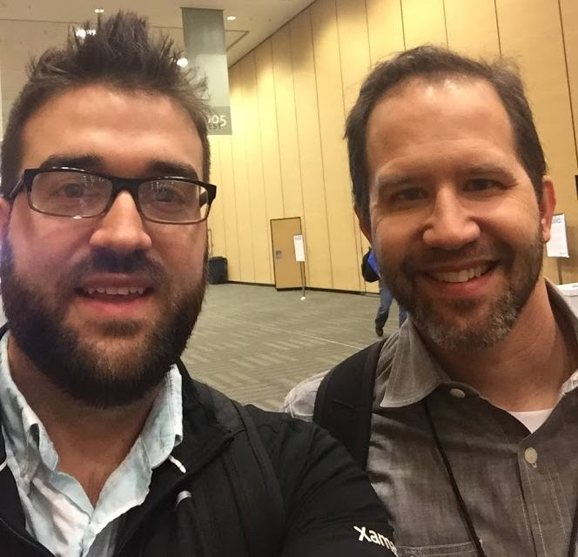
Quote of the day
“Developers who attend technical conferences are among the top 1% of all developers”
Scott Hanselman

Slide 6
Today’s Agenda
Let’s Talk about building a “Magic Mirror”

Slide 7
Agenda
Inspiration
Hardware
Platform / OS
Software
Construction

Slide 8
Inspiration
Why would anyone want to do this?

Slide 9
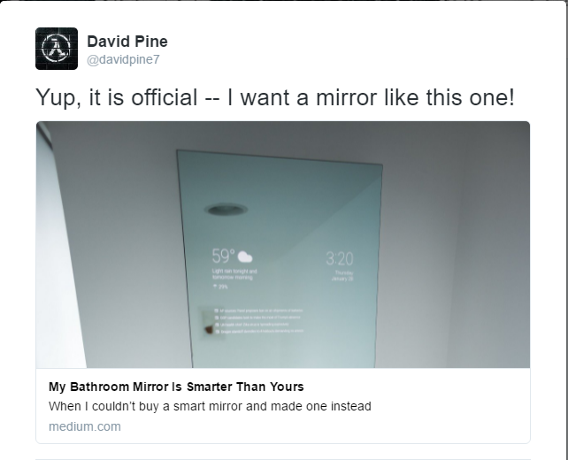

Slide 10
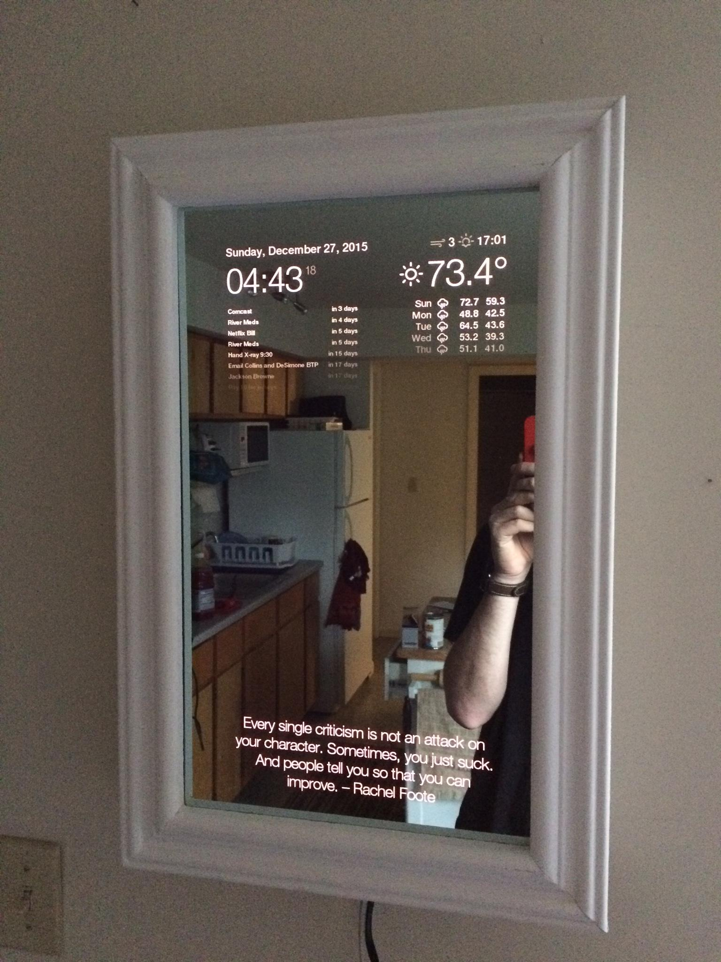
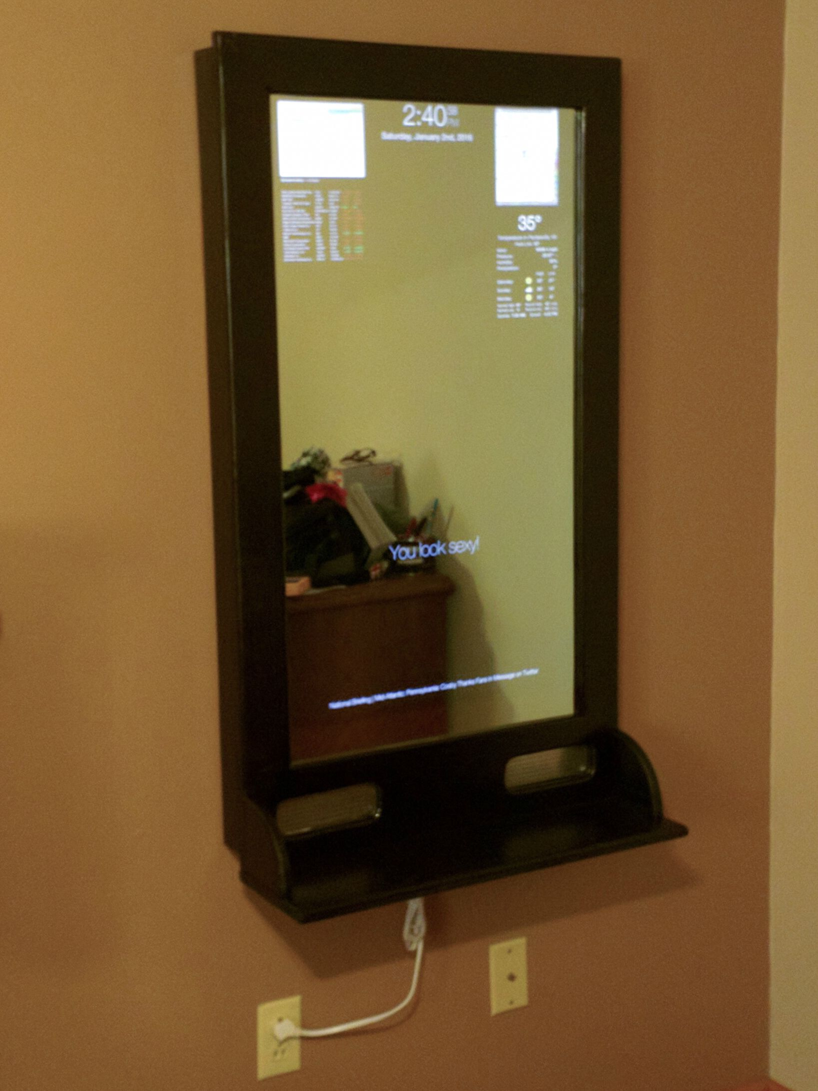
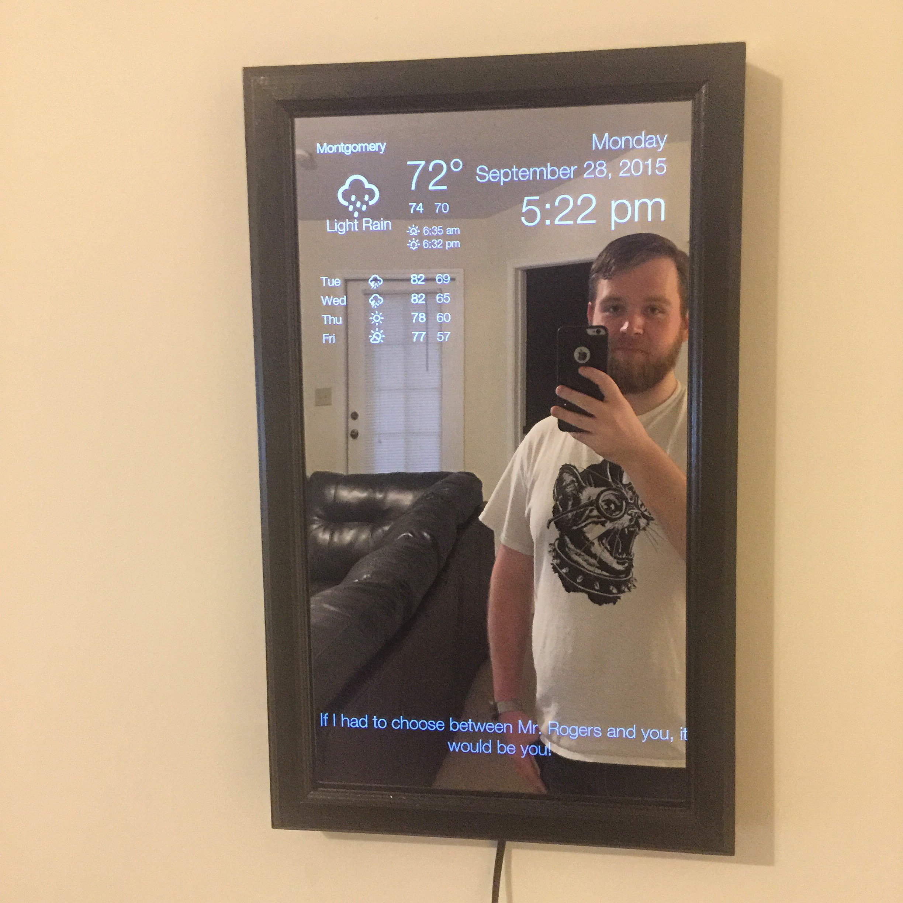
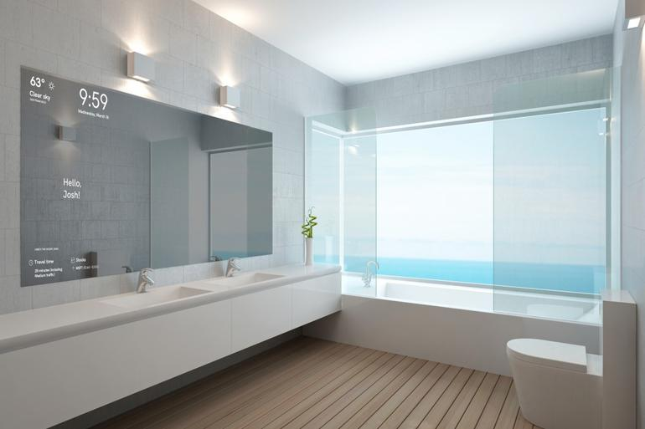
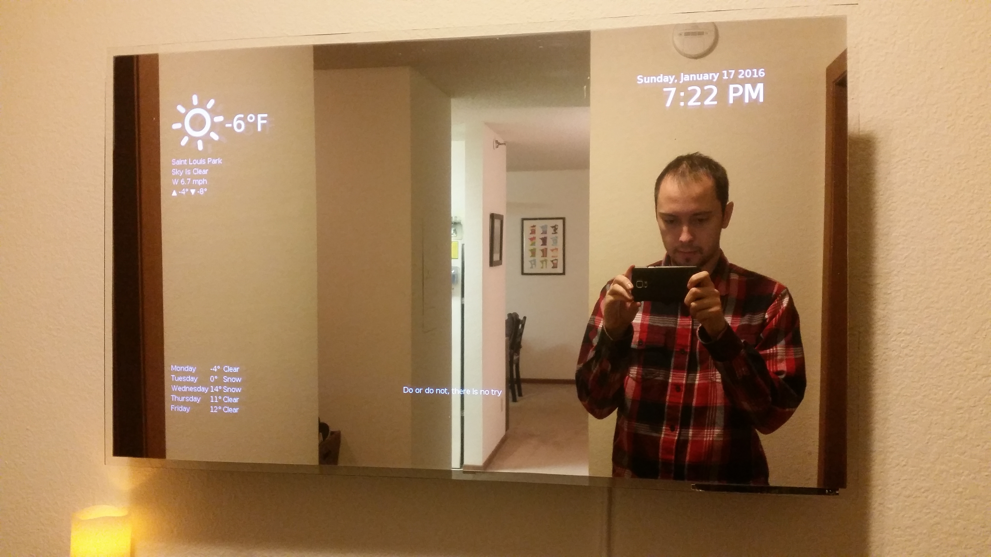

Slide 11
Hardware
All the Pieces

Slide 12
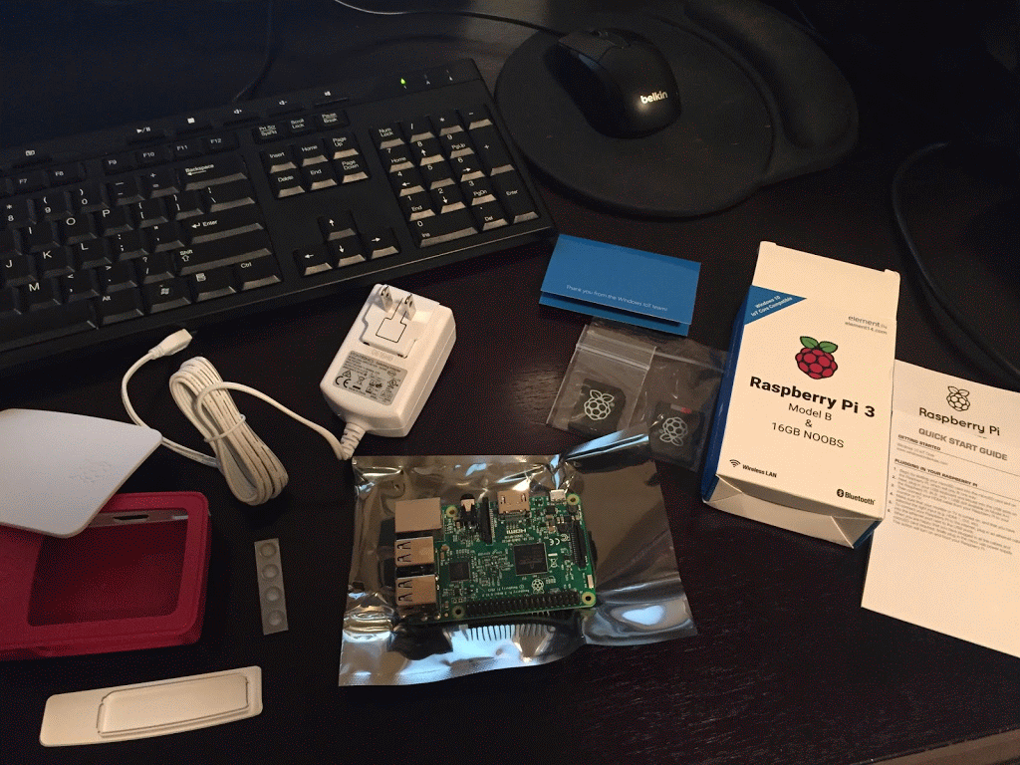

Hardware
Notes:
The Raspberry Pi 3 Model B
4x USB slots, Full HDMI, 40x pin GPIO
Built-in Wi-Fi and Bluetooth
1.2 GHz 64-bit quad-core ARMv8 Cortex-A53 CPU
1 GB RAM
MicroSDHC for storage

Slide 13
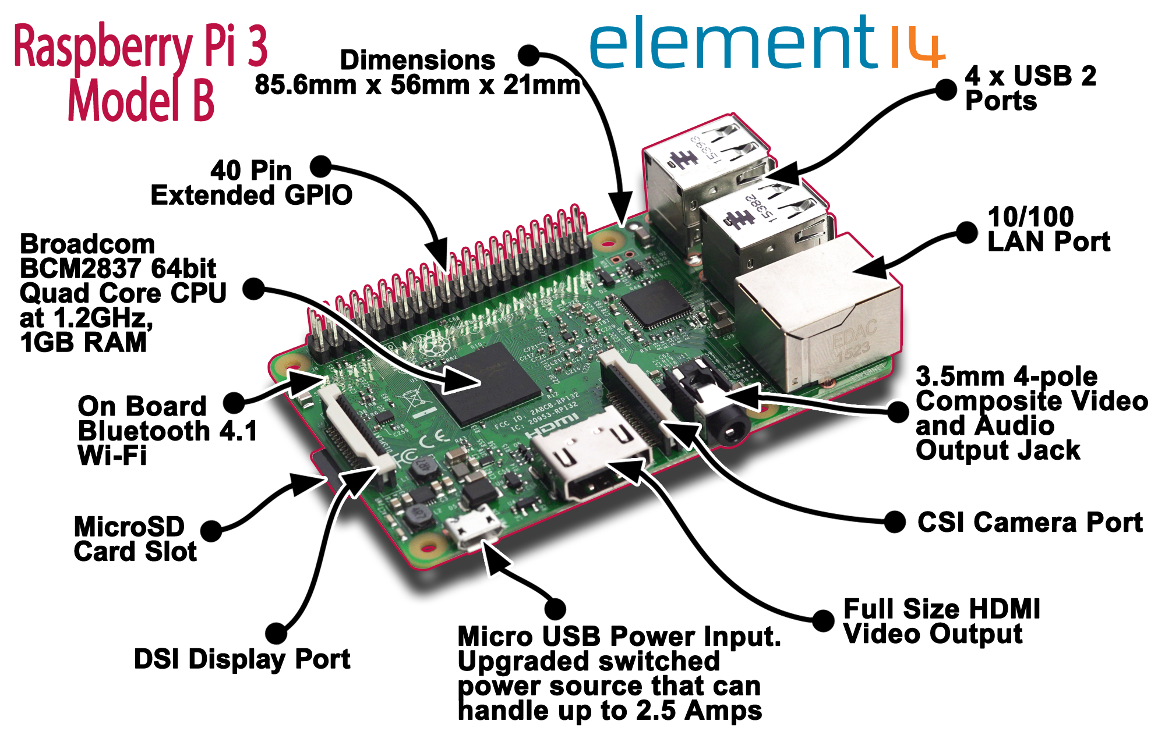
Notes:
The Raspberry Pi 3 Model B
4x USB slots, Full HDMI, 17x pin GPIO
Built-in Wi-Fi and Bluetooth
1.2 GHz 64-bit quad-core ARMv8 Cortex-A53 CPU
1 GB RAM
MicroSDHC for storage

Slide 14
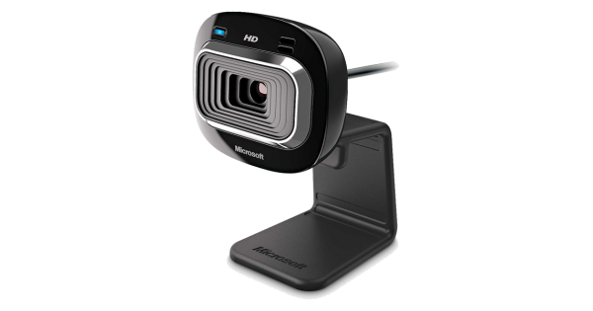

Hardware
Notes:
Microsoft LifeCam 3000, USB
720p HD – under $40

Slide 15
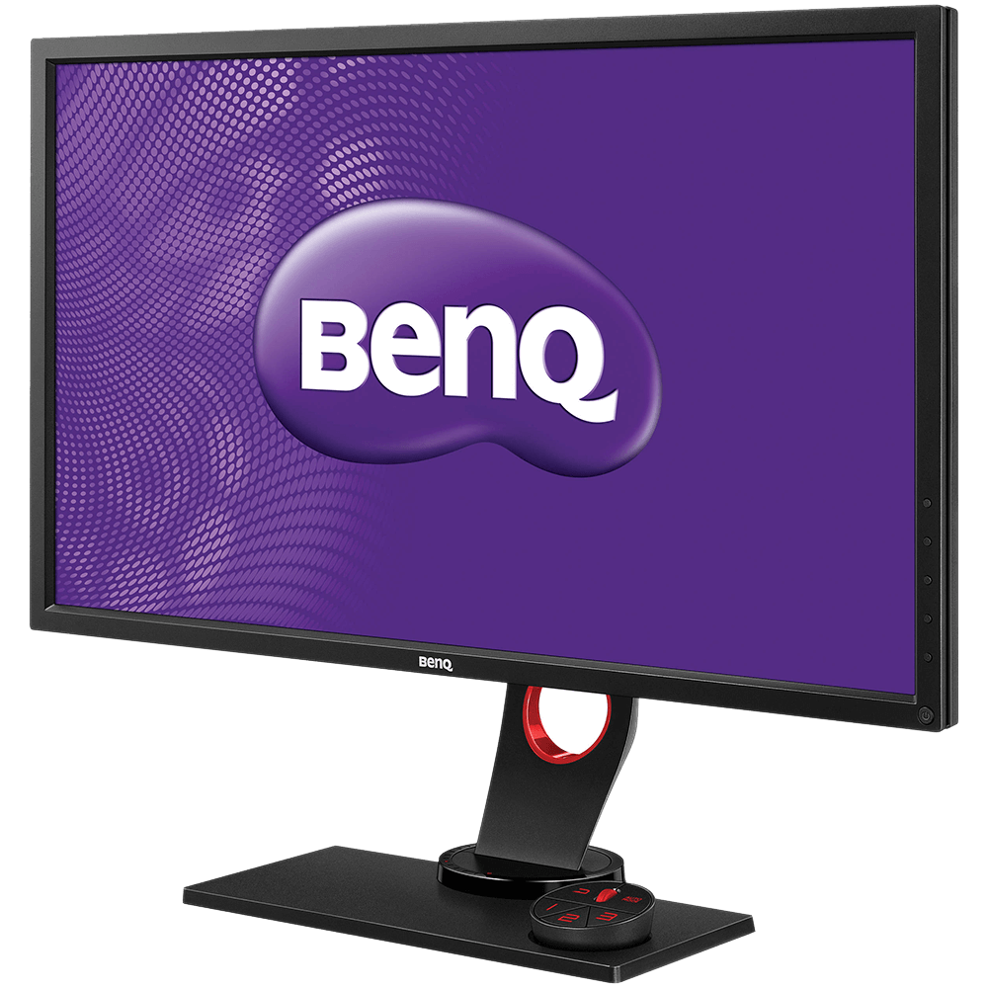
Hardware
Notes:
BenQ 27 inch, HDMI LED Monitor $170.00 on Amazon

Slide 16
Miscellaneous Hardware
Dell USB Wired SoundBar
Full HDMI Cable
USB Extension Cables
Custom-sized Mirrored Acrylic Two-Way
Carpentry Materials (for frame)

Slide 17
Platform / Operating System
What it Runs On

Slide 18


Windows 10 IoT Core
Devices such as Pi 2 and 3, DragonBoard, MinnowBoard, etc.
Universal Windows Platform (UWP)
Notes:
XAML based, like WPF… but different, C# 6.0 and .NET Core

Slide 19
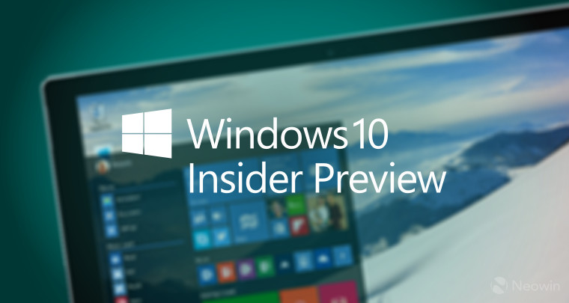
Caveats
Shaped like a football, because I felt like I wanted to kick it!
Windows Insider
Windows updates
Build stability
Deployment issues
Version incompatibility

Slide 20

Demo
Notes:
Windows Device Portal

Slide 21
Software
Hardware and Platforms are nothing without the Software that runs on them

Slide 22
Software is simply the movement and manipulation of data
David Pine (MKE DOT NET 2016)
But without context,
said data is meaningless

Slide 23
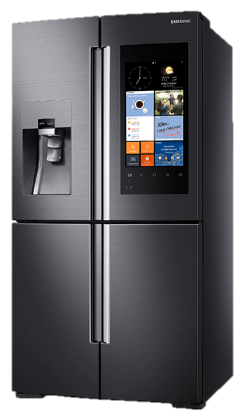
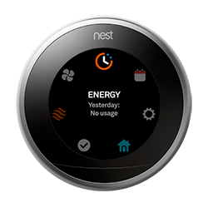
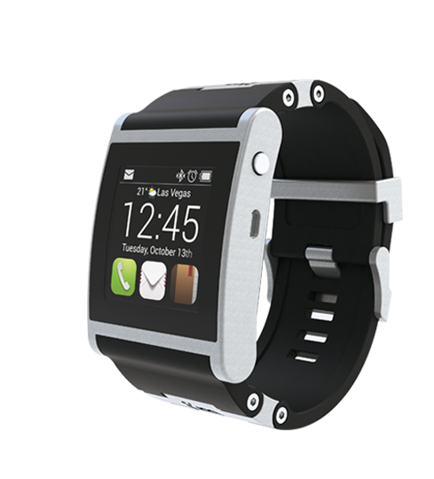
Context is everything
Relevance
Common Sense
Practicality
Convenience
Ease-of-use
Accessibility
Timely

Slide 24
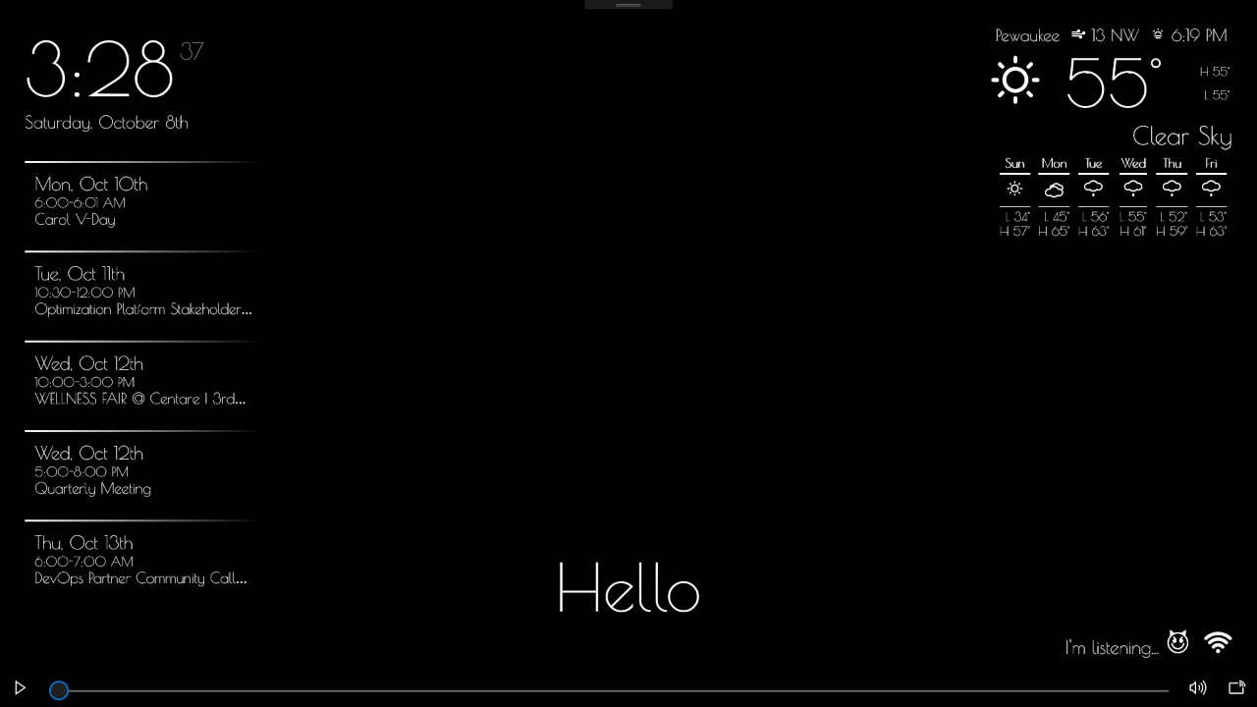
Clock
Current Weather
Event Calendar
Forecast
Music Player
Network Connectivity
Greeting
Emotion API Indicator
Voice Command Status

Slide 25
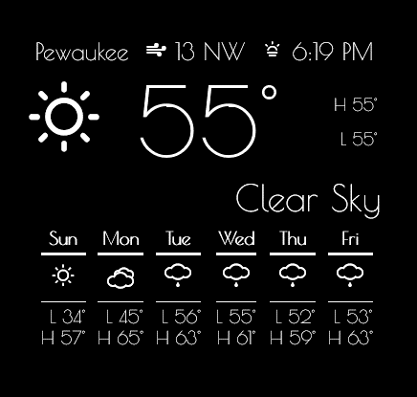

Implements…
Configurable
City
Sunrise / Sunset
Current Conditions
7-day Forecast
IContextSynthesizer

Slide 26
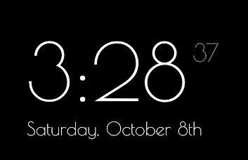
Does not implement
Seconds
IContextSynthesizer

Slide 27
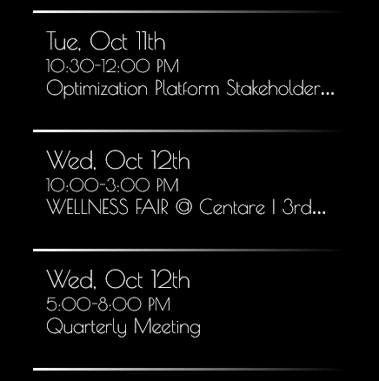

Implements…
Date
Start / End Time
Subject
IContextSynthesizer
Notes:
.ical or .ics

Slide 28
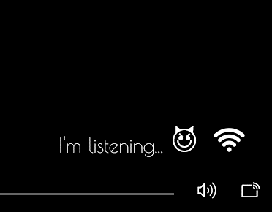
Implements…
Speech Engine
Current Emotion
Typically
WIFI
IContextSynthesizer

Slide 29
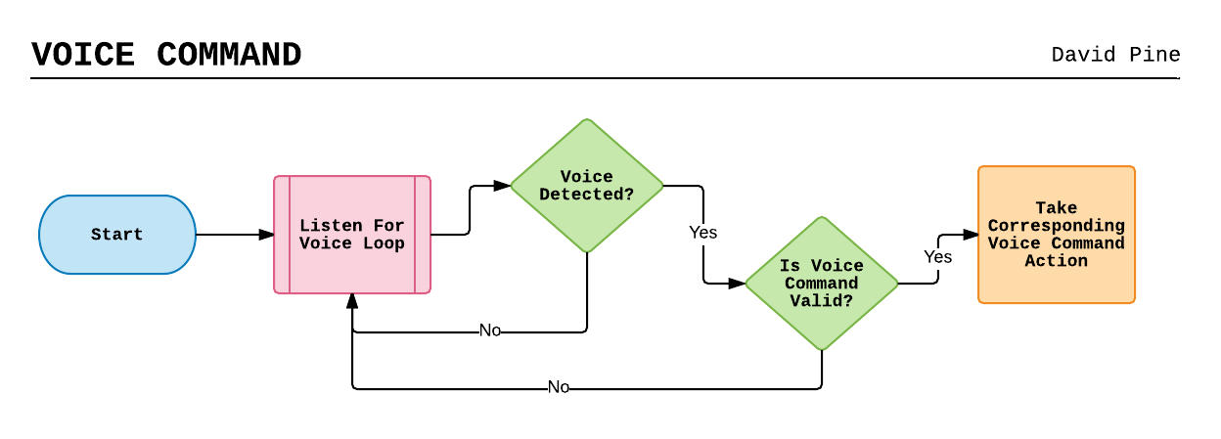
Speech Recognition / Synthesizer
Notes:
This is actually native to the device it runs on, i.e.; Windows 10 IoT Core provides libraries as part of UWP that are native – no external calls are made.

Slide 30
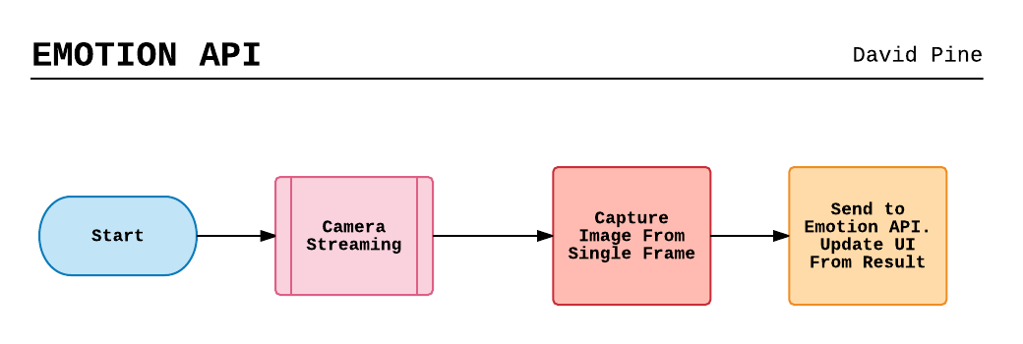
Microsoft’s Cognitive Services Emotion API
Notes:
Assumptions:
A camera is accessible
A face is detected
We have an Azure Emotion API Subscription Key
This is not native…

Slide 31
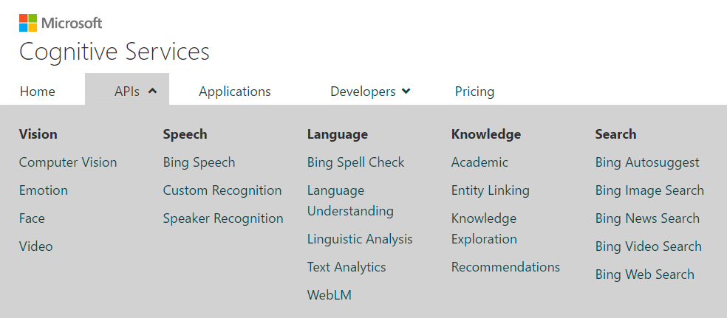
Microsoft’s Cognitive Services
FREE
https://www.microsoft.com/cognitive-services

Slide 32
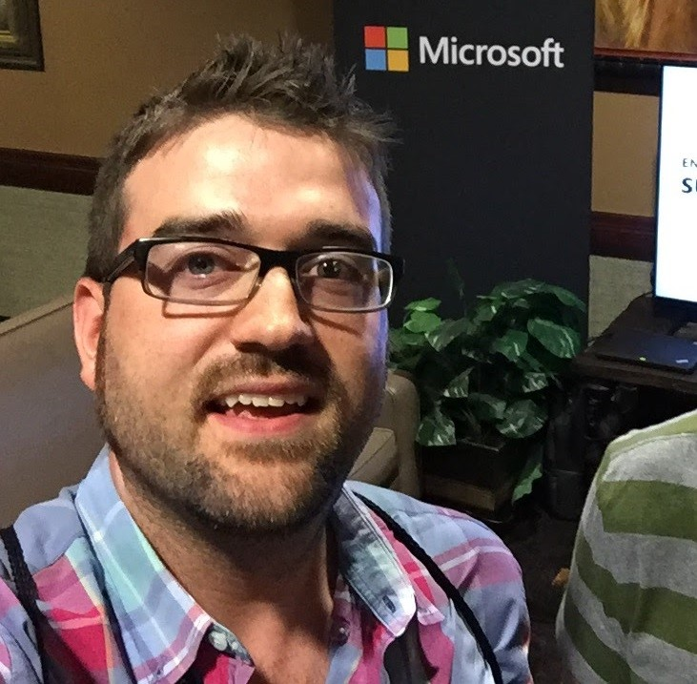
Microsoft’s Cognitive Services
public class Scores
{
public float Anger { get; } = 0.00129610463;
public float Contempt { get; } = 0.00300570647;
public float Disgust { get; } = 0.0124403676;
public float Fear { get; } = 0.000501405157;
public float Happiness { get; } = 0.815216839;
public float Neutral { get; } = 0.159056842;
public float Sadness { get; } = 0.00463912;
public float Surprise { get; } = 0.00384359085;
}
https://www.microsoft.com/cognitive-services

Slide 33
Construction
Putting it all together

Slide 34


BOSS
BOOZE
Notes:
My boss + a bottle of single malt scotch whiskey =

Slide 35

CARPENTARY WORK

Slide 36
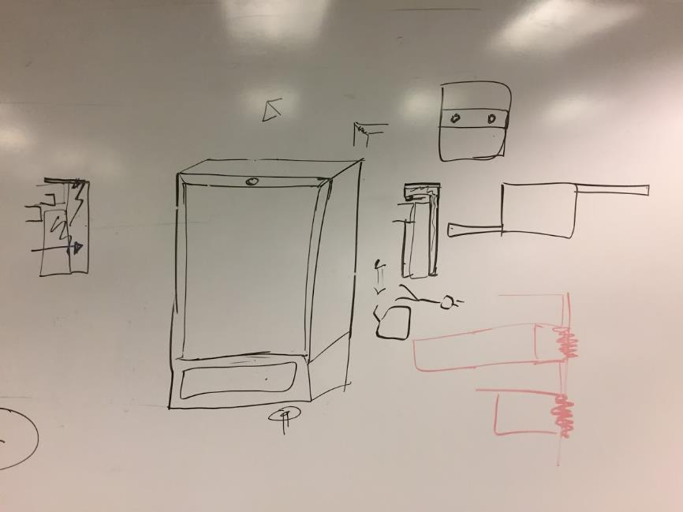
Brainstorming…
White boarding…

Slide 37
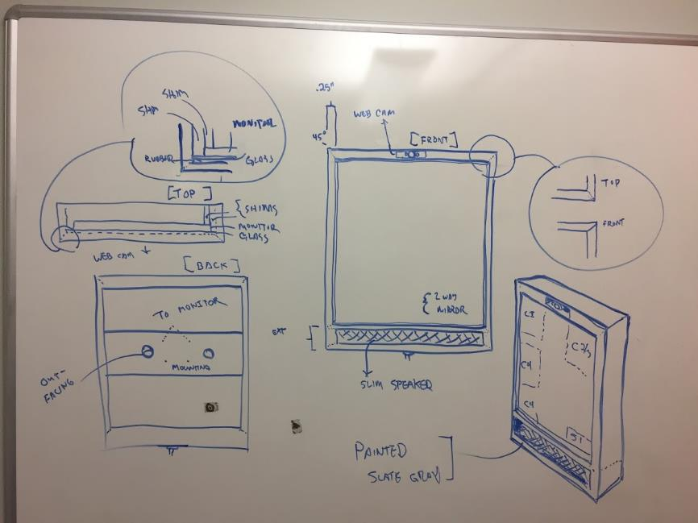
Drafting…
Designing…

Slide 38
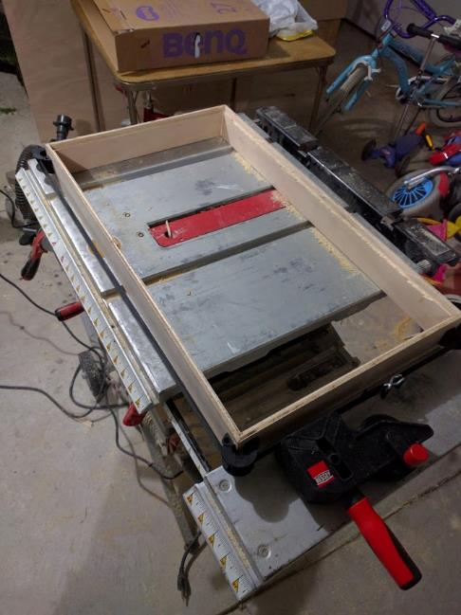
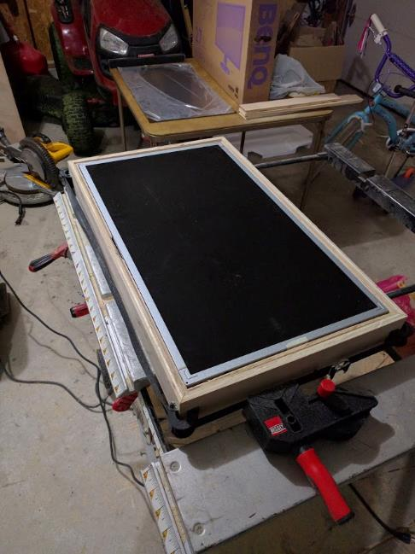

Slide 39
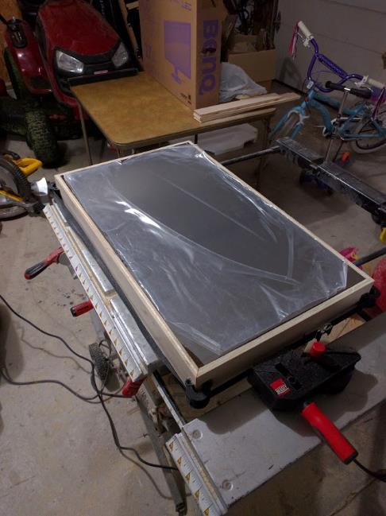
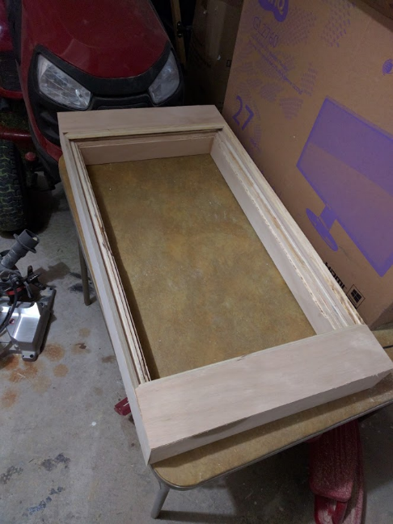

Slide 40
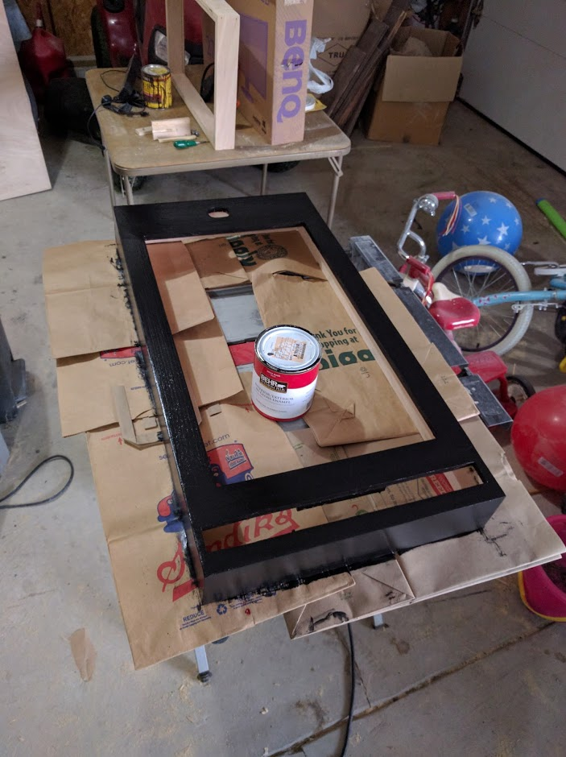
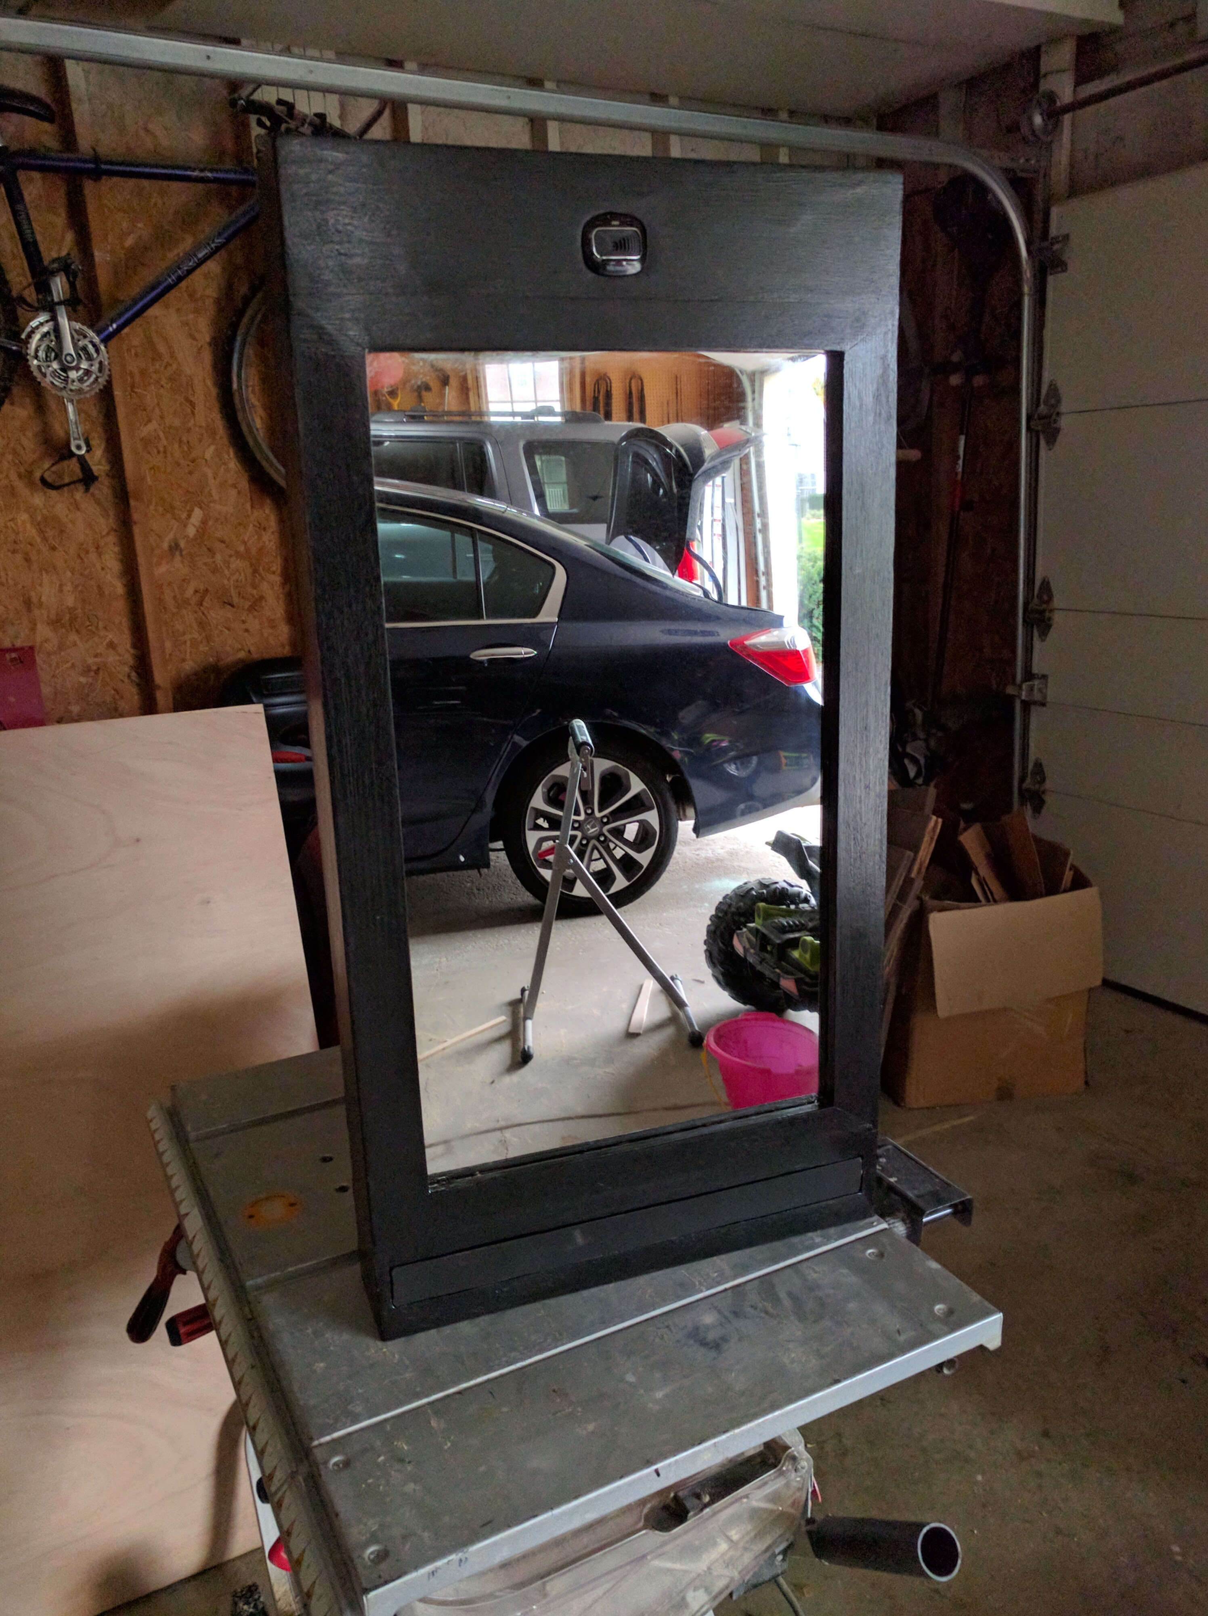

Slide 41
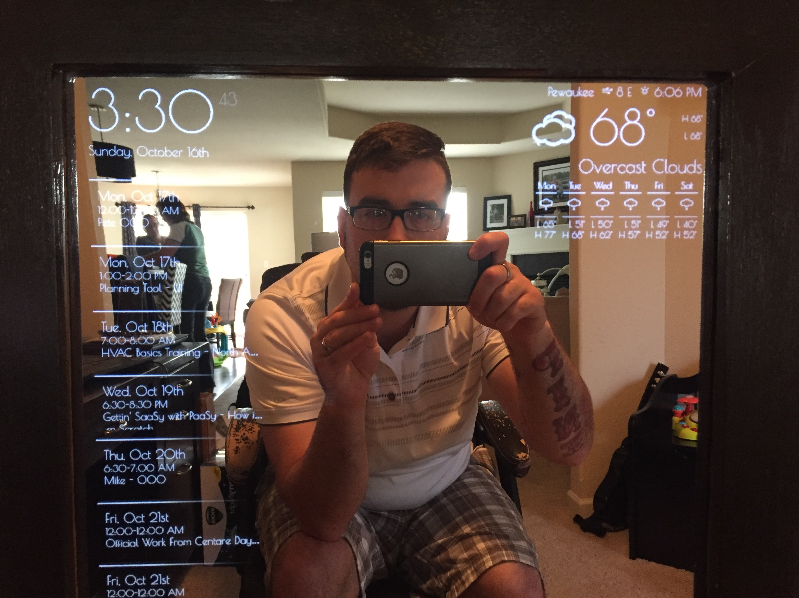

Slide 42
Demo

Slide 43
Thank you!!

